Slide 1
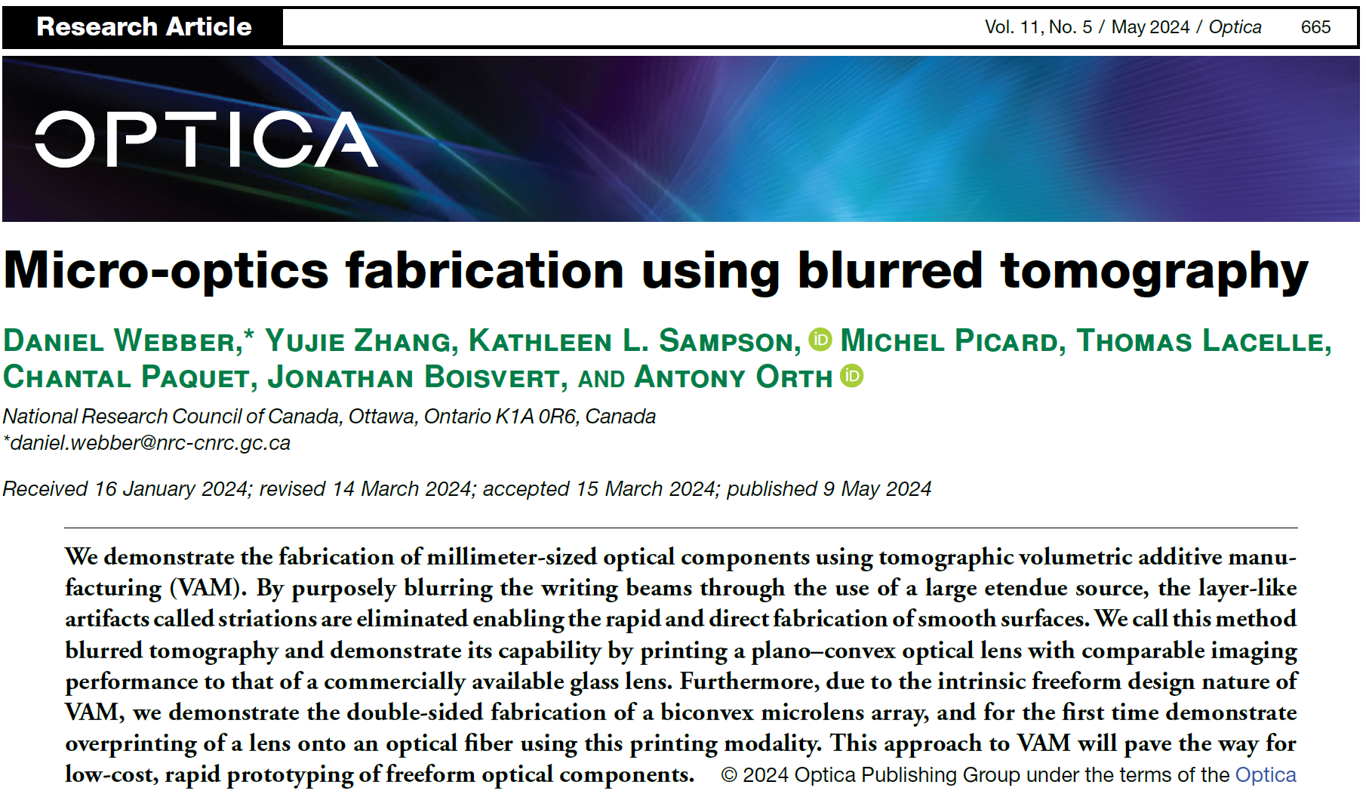

Slide 2
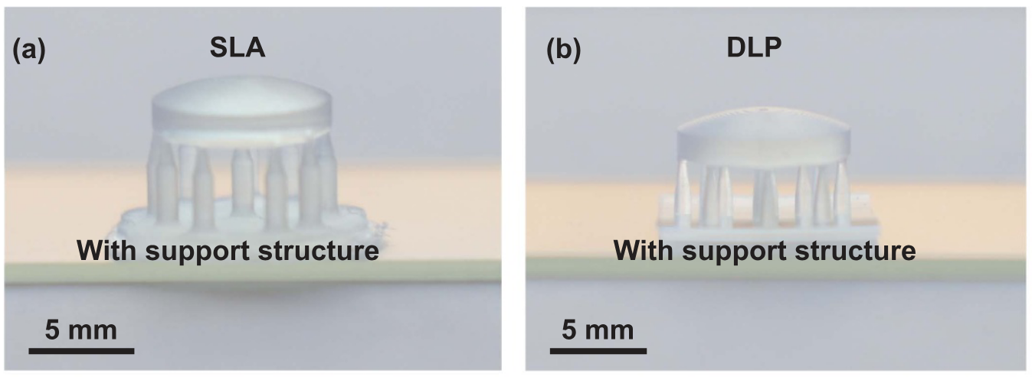
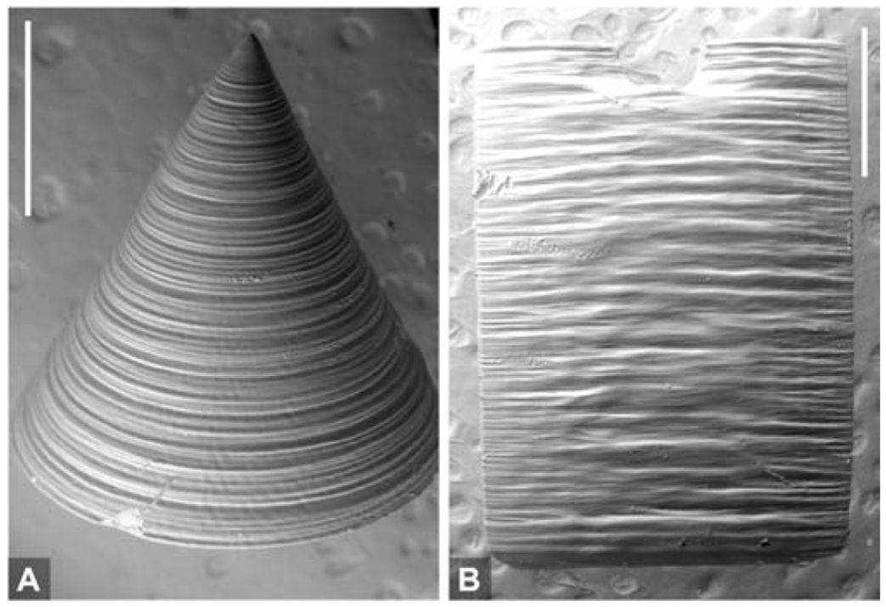
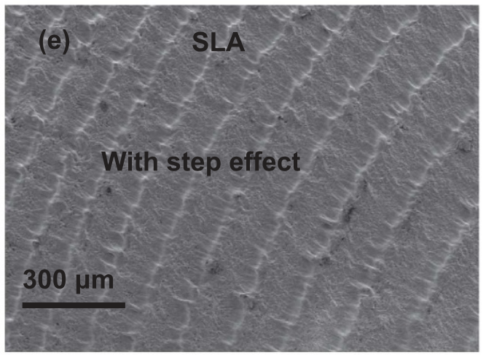
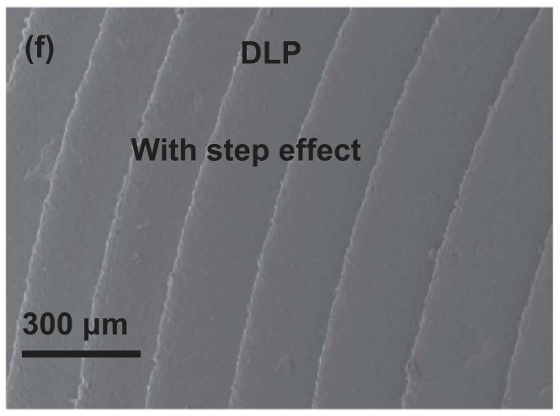
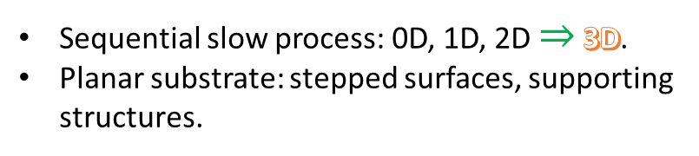
Introduction
Additive Manufacturing of optical components
Inkjet printing.
Vat-polymerization: DLP, SLA.
Two-photon polymerization.
Volumetric additive manufacturing VAM.
Sequential slow process: 0D, 1D, 2D $⇒$ 3D.
Planar substrate: stepped surfaces, supporting structures.
VAM suffers from layer-like artifacts: Striations - Self-writing waveguide effect.
Shuai Peng et al 2023 Int. J. Extrem. Manuf. 5 035007
Opt. Lett. 47, 1279-1282 (2022)

Slide 3
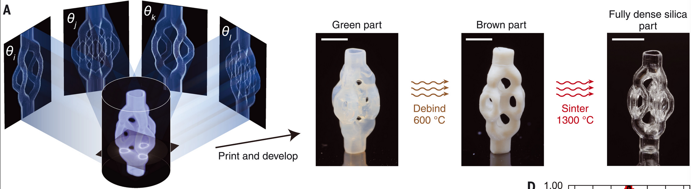
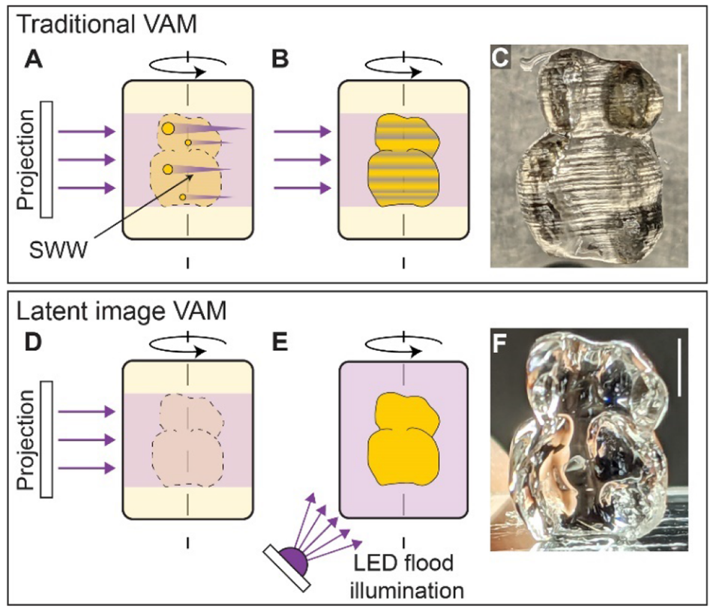
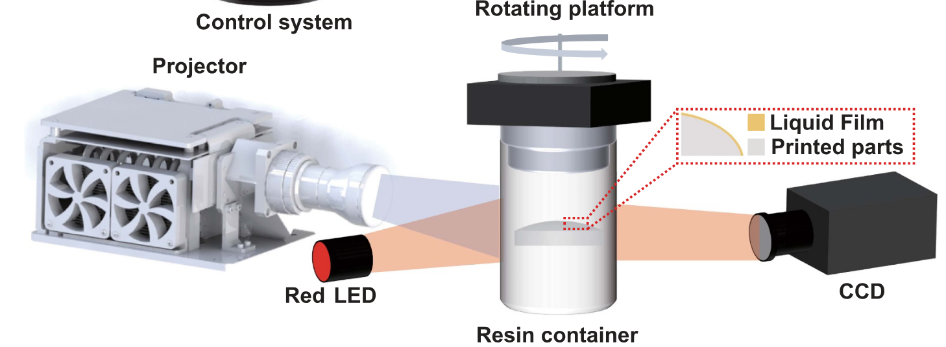
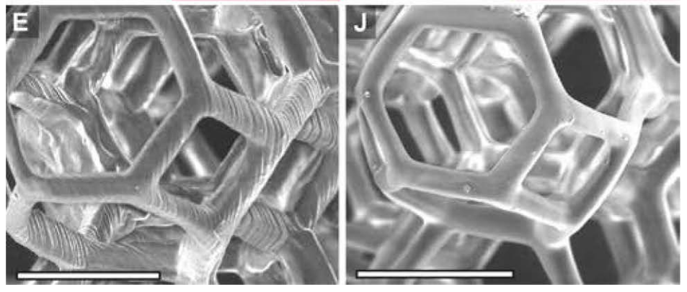
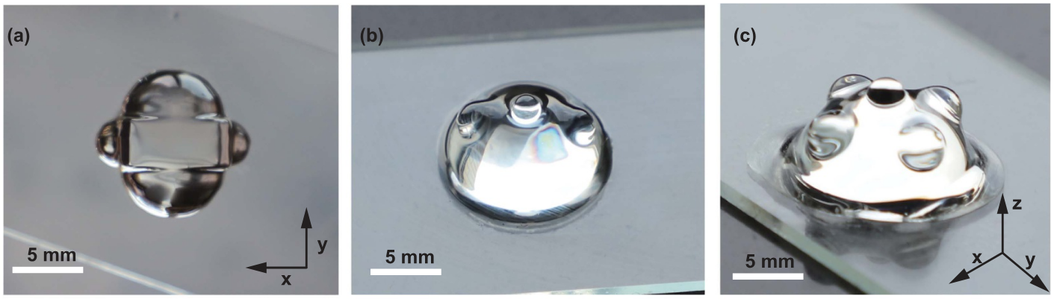
Strategies for VAM
Post-processing: silica-embedded polymer
Flood illumination
Science 376,308-312(2022).
Thin-film of uncured photoresin
Int. J. Extrem. Manuf. 5 (2023) 035007
Opt. Lett. 47, 1279-1282 (2022)

Slide 4
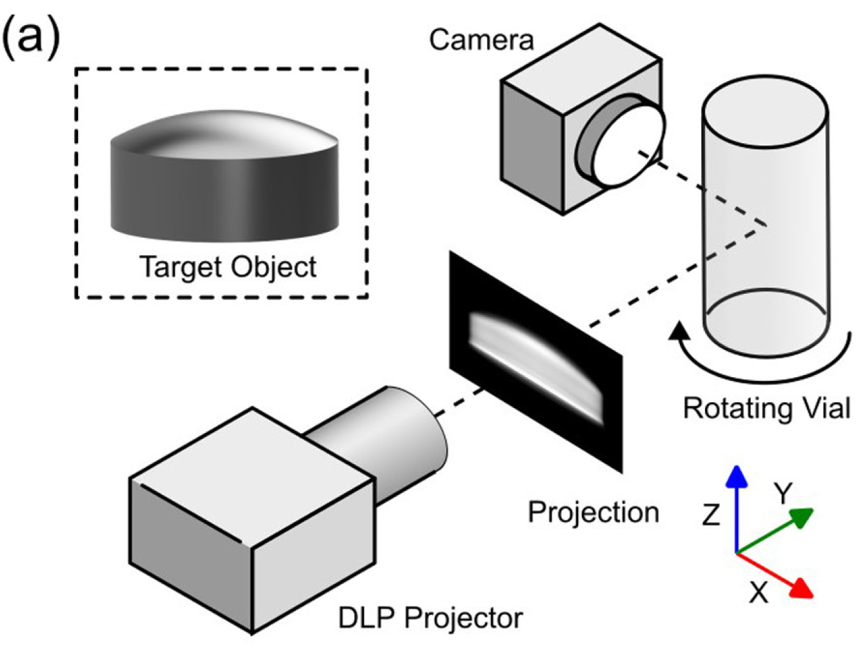
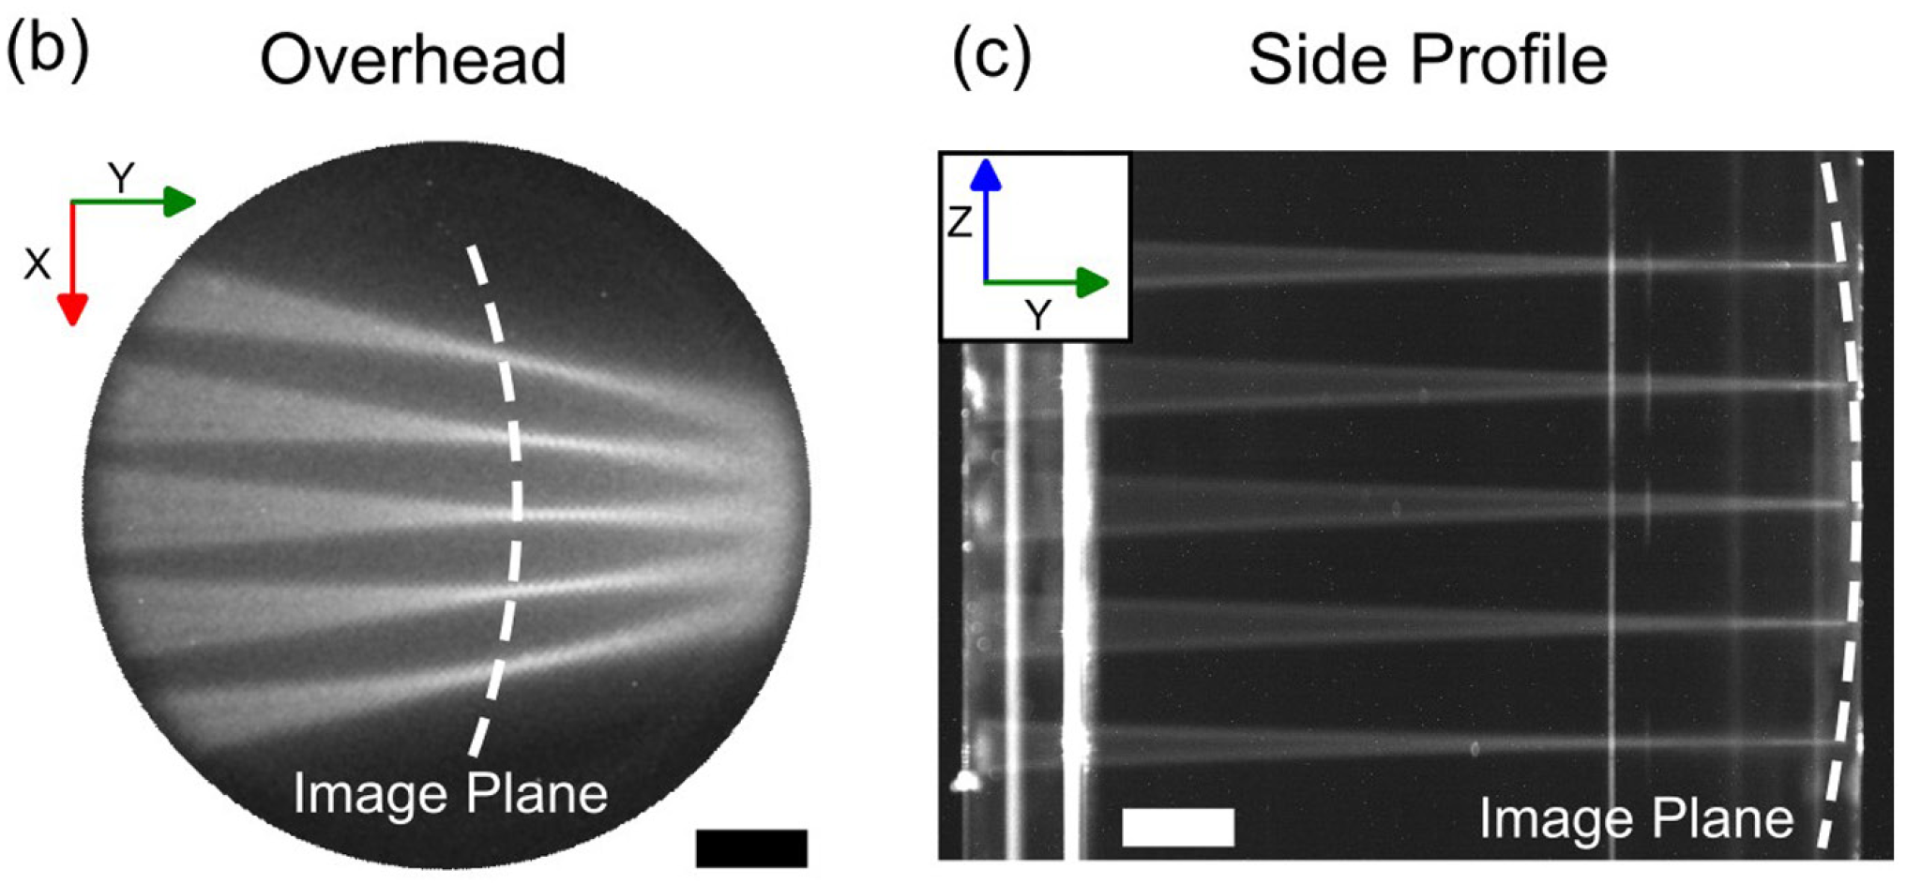
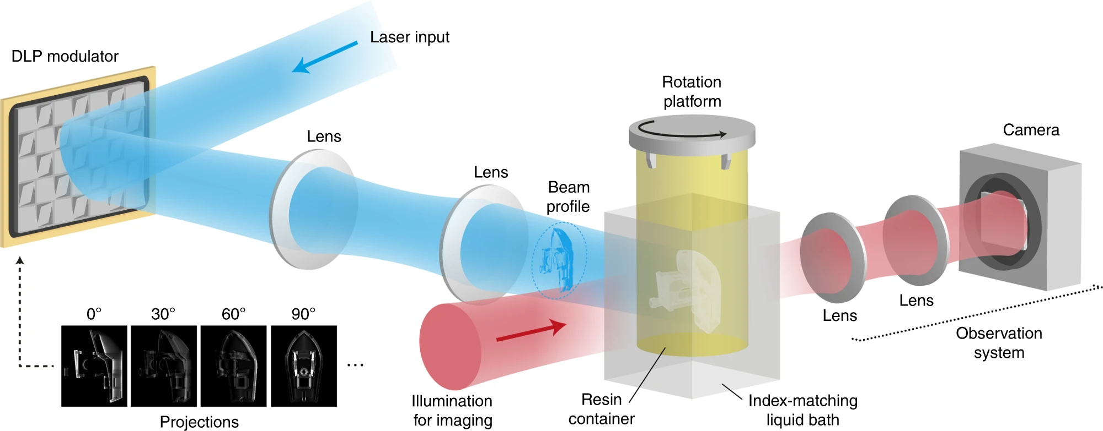
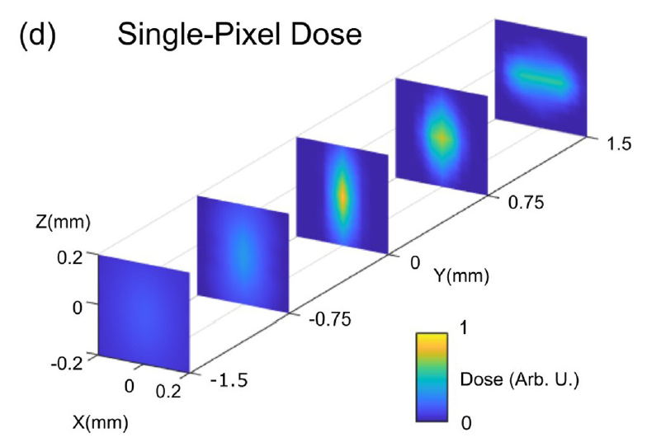
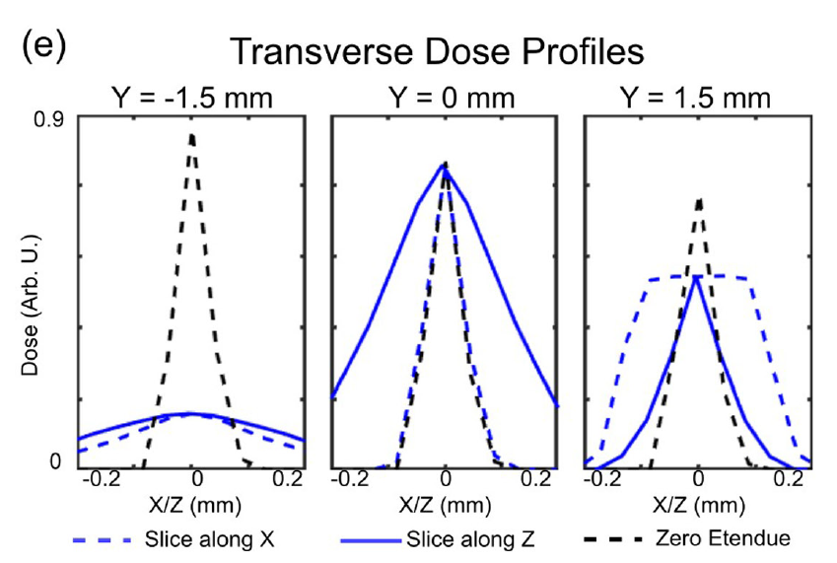
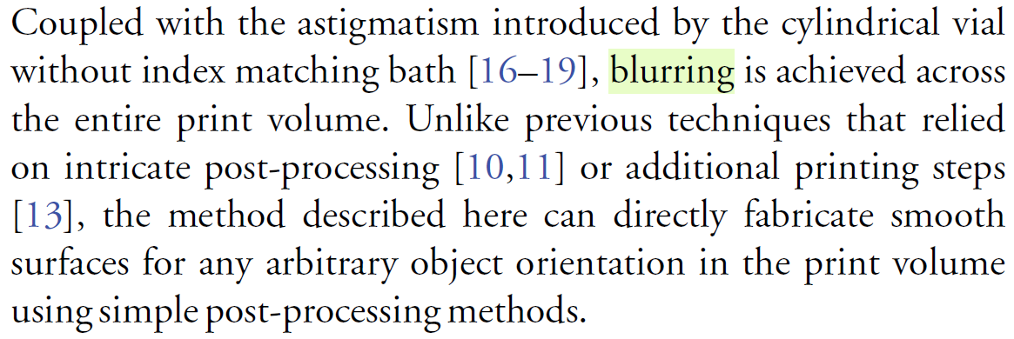
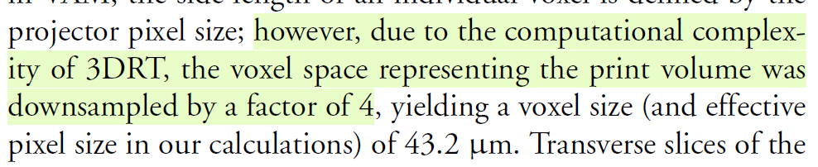
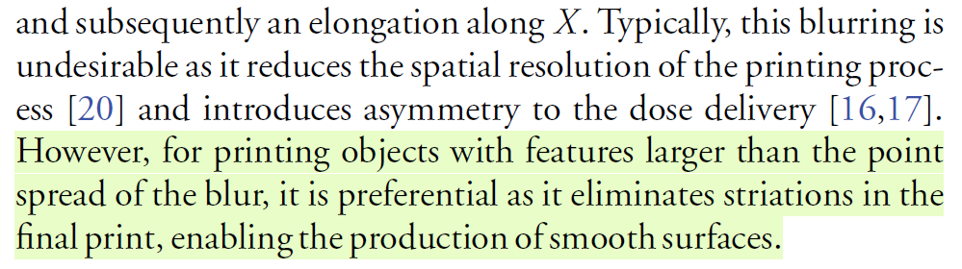
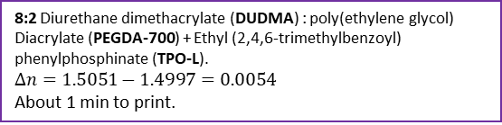
Methods
Pixel size at the focal plane same as pixel size of DMD: 10.8 µm
No index-matching bath
No low etendue.
No software correction for scattering, dose blurring or cylindrical lens effect.
No additional post-processing.
3D ray tracing.
8:2 Diurethane dimethacrylate (DUDMA) : poly(ethylene glycol) Diacrylate (PEGDA-700) + Ethyl (2,4,6-trimethylbenzoyl) phenylphosphinate (TPO-L).
$$Δn=1.5051−1.4997=0.0054$$
About 1 min to print.
Nat Commun 11, 852 (2020)
Telecentric lens f/#=4.64, etendue = $4.153×{10}^{−6}\text{sr} {\text{mm}}^{2}$

Slide 5
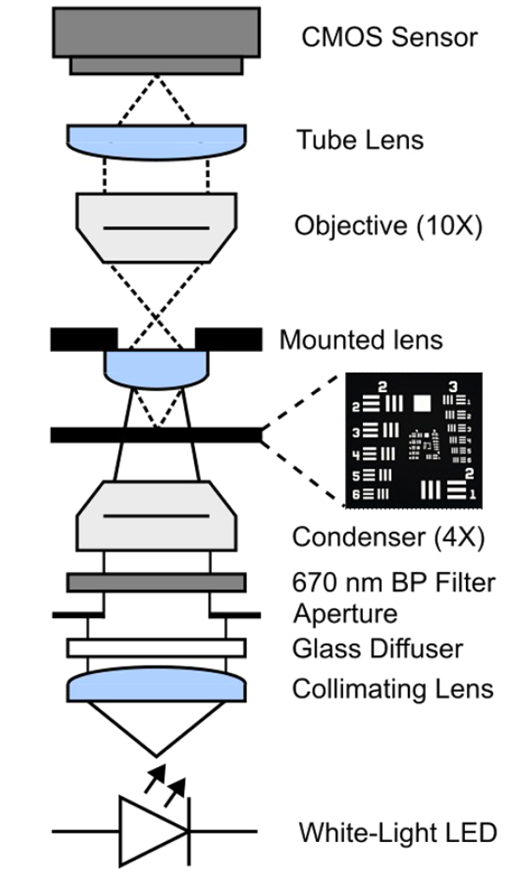
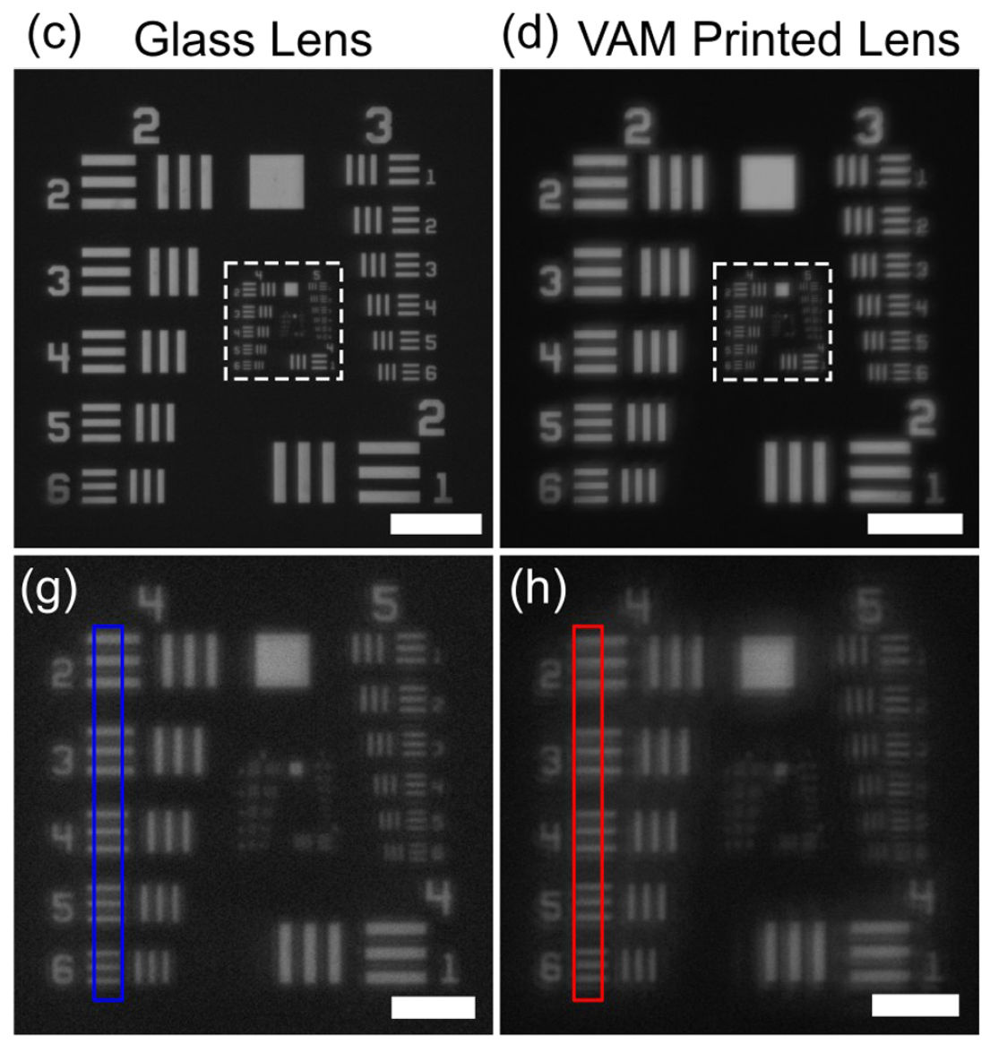
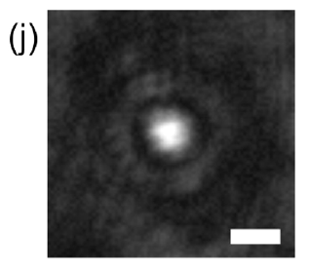
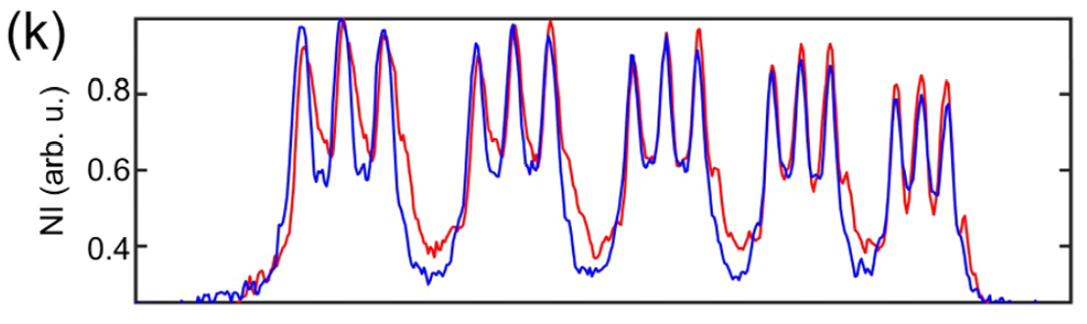
Tomographic Projection Calculation
Short depth of field: Dose delivered ≠ Target $⇒$ Dimensional errors
Correction using 3D ray tracing 3DRT:
Coordinates at print volume
Tomographic projection of the target
Compute light dose delivered
Post-processing
Pixel at projector
Compare
1 min in isopropanol + 20 min in isopropanol + air dry + Flood exposure in vacuum (405 nm) 5 min.
19 rays per pixel
20 iterations
Modify
Results
Evaluation of Printed Lens Imaging Performance
Target: Plano-convex lens THORLABS: 3.1 mm radius of curvature, 1.5 mm center thickness, 3 mm diameter. N-BK7
 | Glass lens | VAM printed
Michelson contrast (G 4) | 0.51–0.21 | 0.48–0.16
Smallest element | G 5, E 6, 8.77 µm | G 5, E 5, 9.84 µm
Laser spot size | 7.0 ± 0.4 µm | 14.0 ± 0.4 µm

Slide 6
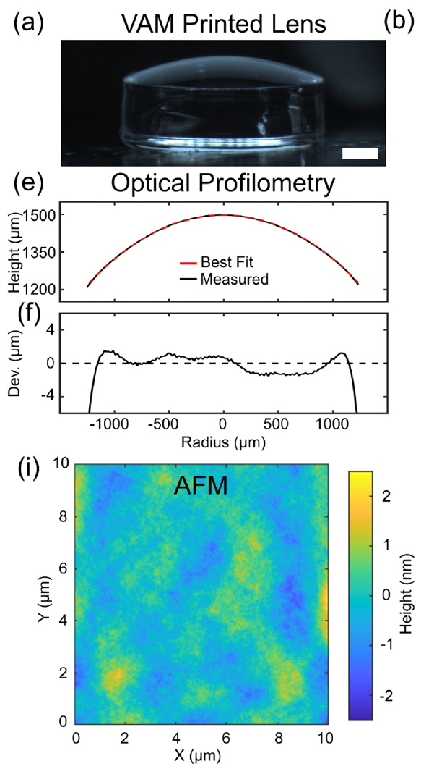
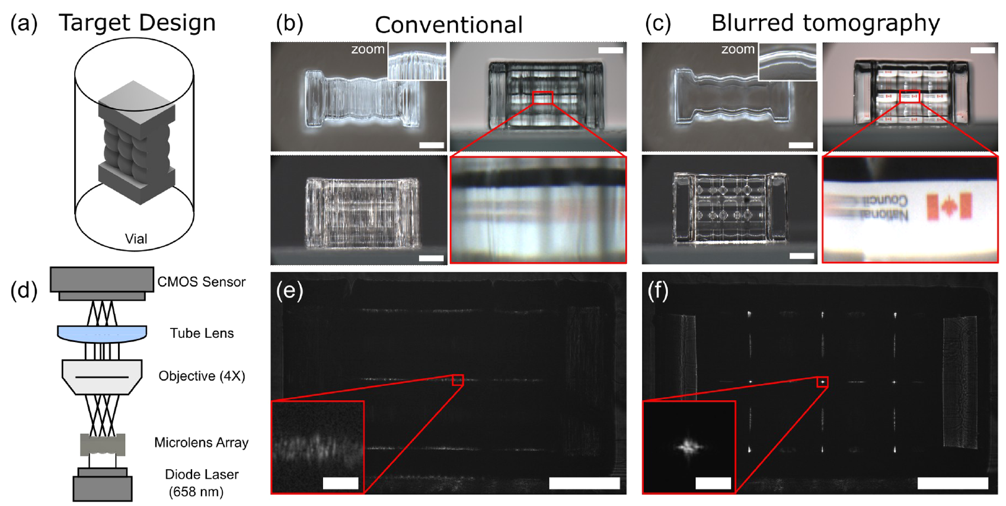
Results
Evaluation of Printed Lens Imaging Performance
Elimination of Striations and Printing of Microlens Arrays
3x3 biconvex microlens array (MLA). each lenslet has a spherical surface with a radius of curvature of 1 mm (effective focal length D 1.57 mm) and fills a 1 mm x 1 mm square aperture.
 | Glass lens | VAM printed
Radius of curvature | 3.1 mm | 2.94 ± 0.01 mm
Deviation from curve | 0.95 µm - 3λ/2 | 2 µm – 3.1 λ
Refractive index | 1.515 | 1.5051
RMS surface roughness |  | 0.53 nm 10x10 µm²
Diameter | 3.00 mm | 2.81 mm

Slide 7
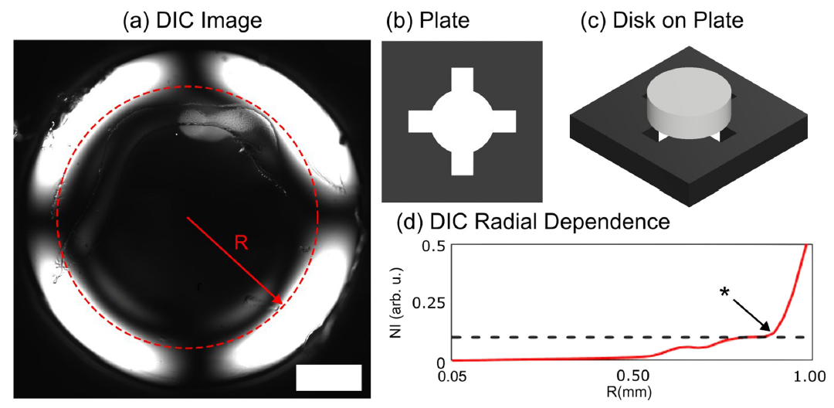
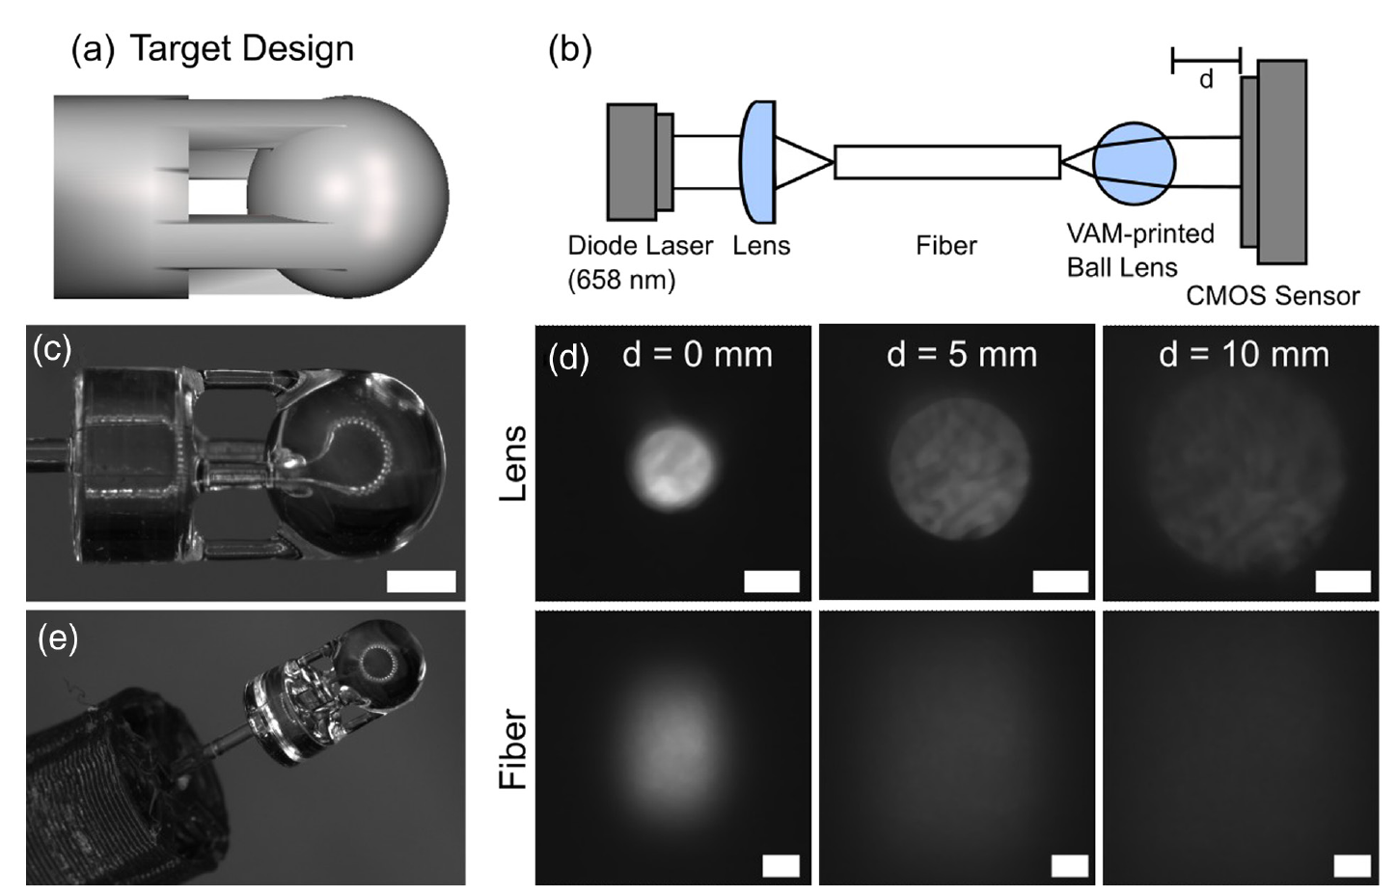
Results
Optical fiber overprinting
Differential Interference Contrast Measurement of the Disk
Ball lens (diameter 3mm)is printed with a supporting structure to enable overprinting to the optical fiber (PMMA, diameter D 0.5 mm, NA D 0.23).
From simulation of dose contrast, the spatial resolution limit is 172.8 µm.
Reduction in beam divergence (5.4 deg versus 13.5 deg for the fiber).
Ball lens diameter 2.73 mm instead of 3 mm.
Fiber to lens separation 1.00 mm instead of 0.84 mm.
Intensity variations due to poor cleavage of the fiber end.

